Slide 1

Banking Customer Churn - Prediction
Vinay Nagaraj
DSC680, Summer 2021
Bellevue University, NE

Slide 2
Problem Statement
No Customers = No Sale.
Customer Churn is one of the most acknowledged problems in the banking sector.
Banks are constantly looking at data/suggestions which could help them improve their customer service.
This project intends to focus on the behavior of bank customers who are more likely to leave the bank.

Slide 3
Process Overview
Preliminary analysis on data
Data preparation and cleaning for any missing values.
Perform Exploratory Data Analysis
Train and test models
Model evaluation and tuning

Slide 4
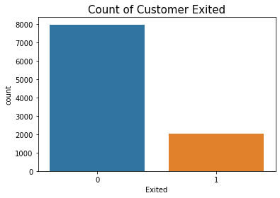
Dataset Overview
The dataset is downloaded from Kaggle which contains details of a bank’s customer.
Out of 10,000 records, 2,037 are data related to customers who exited the bank.

Slide 5
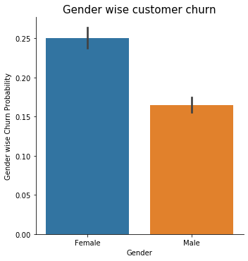
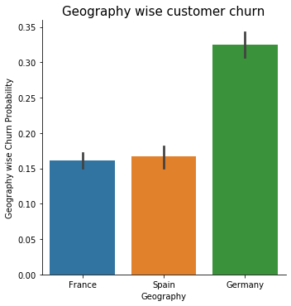
Graph Analysis
Female customers are more likely to exit the bank.
Customers in Germany exit the bank the most.

Slide 6
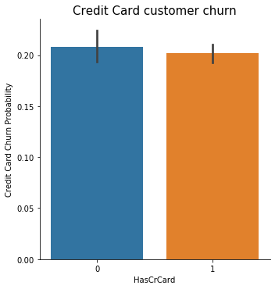
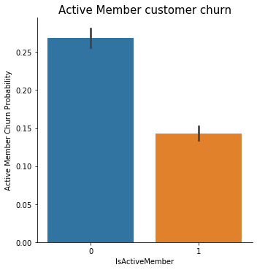
Graph Analysis
Customers with no credit card with the bank tend to exit the bank more.
Important to keep customers active/engaged with the bank. Inactive customers exit the bank.

Slide 7
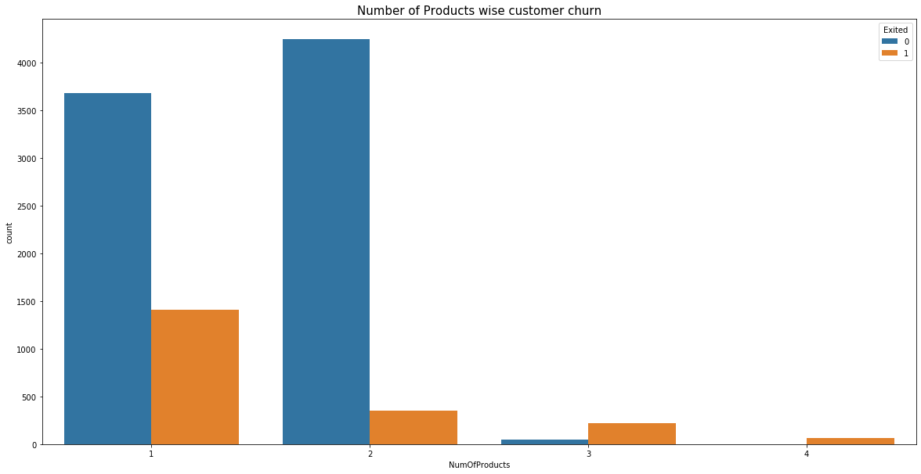
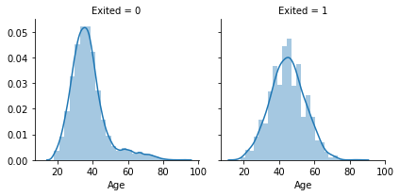
Graph Analysis
The ratio of exited cases with 3 or more products definitely higher than under 2 products.
People with Ages between 30 to 40 has the highest probability of staying and Ages between 45 to 55 has the highest probability of leaving.

Slide 8
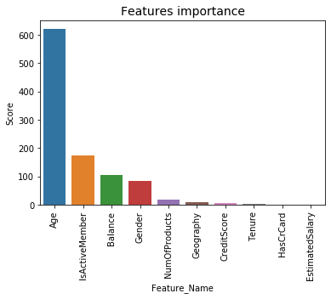
Feature Importance
Target variable – “Exited” which determines if the Customer has exited the bank or not.
SelectKBest technique used to identify most relevant features.
‘Age’ & ‘IsActiveMember’ plays a vital role in Customer Churn.

Slide 9
Classification Models
Aggregate measure of performance across the 7 classification models is shown here.
HyperParameter Tuning - RandomForest, SVC and GaussianNB model due to their accuracy scores.

Slide 10
Random Forest Model
Random Forest Model provides us a high true prediction values for our dataset.
86.1% of the time, our model will correctly predict if the customer will exit the bank or not.

Slide 11
Support Vector Classifier
SVC returns a best fit hyperplane that categorizes our data.
82.16% of the time, our model will correctly predict if the customer will exit the bank or not.

Slide 12
Gaussian Naïve Bayes
Variant of Naïve Bayes that follows Gaussian normal distribution and supports continuous data.
80.85% of the time, our model will correctly predict if the customer will exit the bank or not.

Slide 13
Conclusion
Bank needs to improve on their retirement plans.
Keep Customers engaged and active with the bank. Direct deposits is one such example.
Explain the benefits of your Bank’s credit card to the customer.
Random Forest Model better suited.

Slide 14
References
Shruti_Iyyer. (2019, April 3). Churn Modelling. Kaggle. https://www.kaggle.com/shrutimechlearn/churn-modelling
Why Customers Leave &amp; What Can Banks Do? Tiger Analytics. (2020, September 16). https://www.tigeranalytics.com/blog/addressing-customer-churn-in-banking/
Mukhtar, N. (2020, January 30). Creating a Banking Customer Churn Model. Medium. https://medium.com/@noah.fintech/creating-a-banking-customer-churn-model- 1a2d0850f071

